Slide 1

Android App Development Session 3

Slide 2
Contents
Option Menu
Container
User Interface
Dialogs

Slide 3
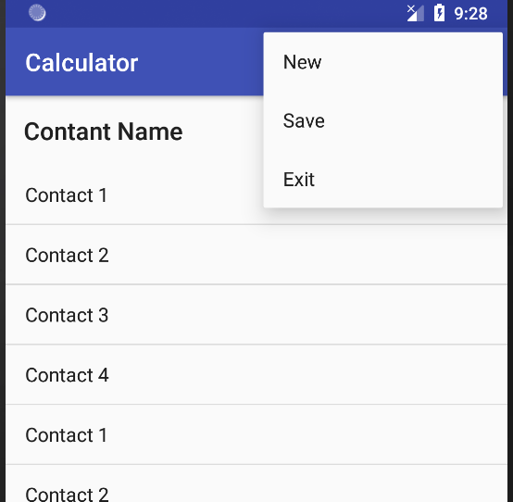
Option Menu
The options menu is the primary collection of menu items for an activity.
It's where you should place actions that have a global impact on the app, such as "Search," "Compose email," and "Settings."

Slide 4
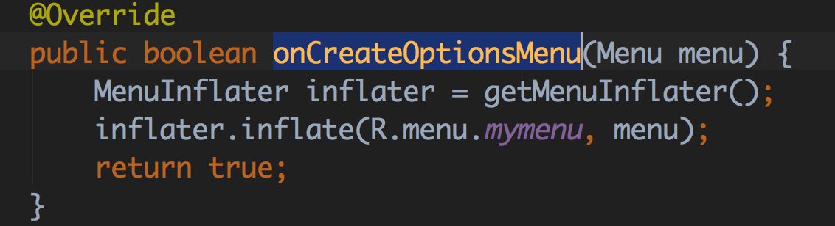
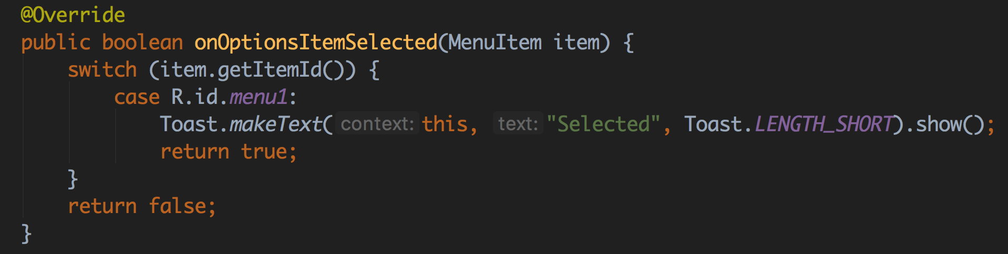
How to create
Create a menu resource file in res folder inside menu folder.
Inflate in onCreateOptionsMenu() method and use in onOptionsItemSelected

Slide 5
Container
ListView
GridView
CardView
RecyclerView

Slide 6
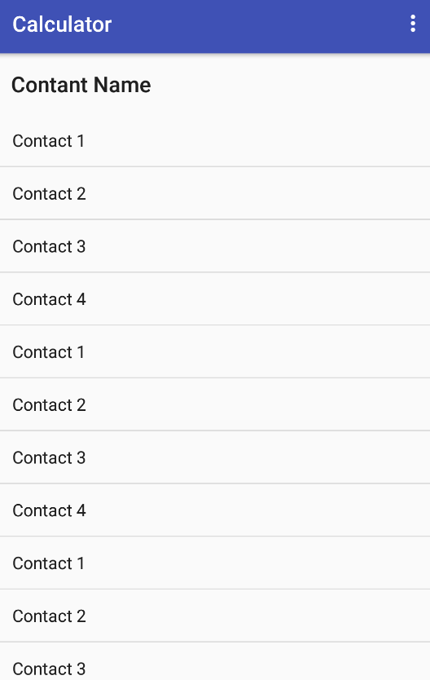
ListView
Items in a list.
Single column.

Slide 7
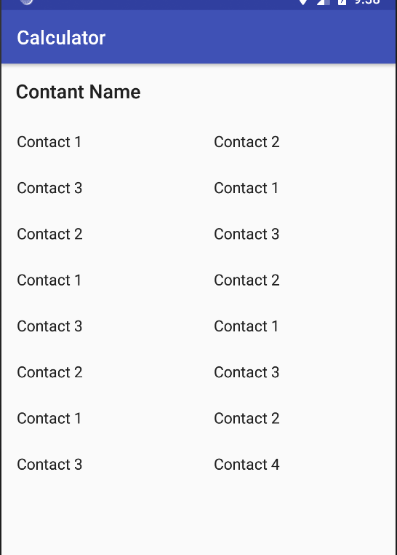
GridView
Shows item in Row and Column
Define the number of column.

Slide 8
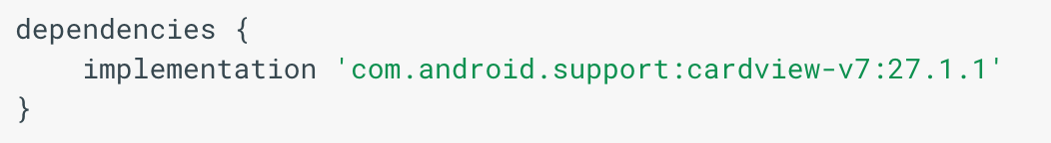
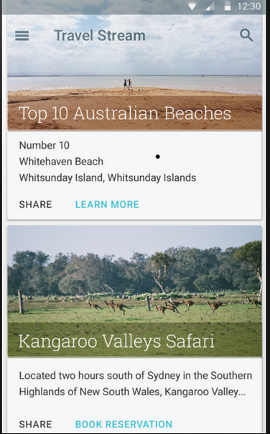
CardView
display data in similarly styled containers.
cards have a default elevation above their containing view group, so the system draws shadows below them.

Slide 9
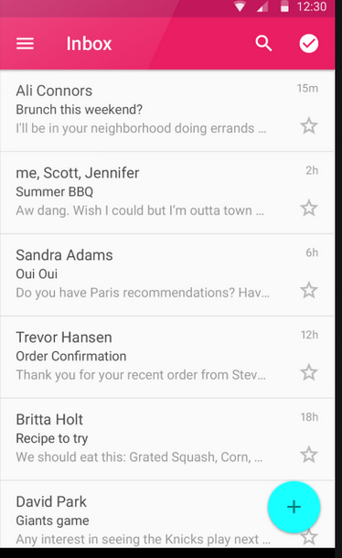
RecyclerView
A flexible view for providing a limited window into a large data set.
Similar to list view and grid view

Slide 10
User Interface

Slide 11

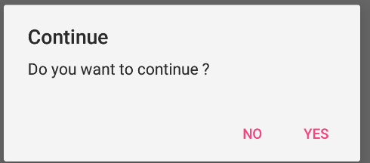
Dialog
Toast Message
Alert Dialog
Snack Bar
Custom Dialog

Slide 12
Let’s Start
<code/>

Slide 13
Thanks!
Any questions?
You can find me at bibesh.manandhar@gmail.com

Slide 14
References!
https://developer.android.com/
https://www.tutorialspoint.com/android/

